Slide 1

Infrastructure and AD-HOC Network.

Slide 2
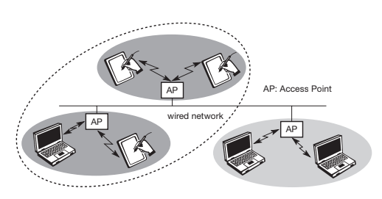
Infrastructure Network
All Access points are directly connected with each other.
Two wireless nodes cannot be directly connected to each other and they can’t directly communicate with each other as well.
Direct communication between wireless node and access point is possible.
Access point acts as a bridge between two wired or wireless networks.
Design of infrastructure based wireless network is simple.
Medium access control mechanism is implemented in access point so that collision won’t happen.

Slide 3
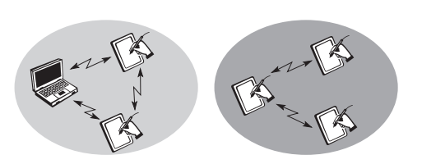
AD-HOC Network
Infrastructure is not required.
Each node can communicate directly with other node in a network.
No access point is required.
Nodes can’t communicate with each other if they are not in network or range.
In AD-HOC network the complexity of each node is higher.

Slide 4
THANK YOU

